Slide 1
ACT Scores in TN
Aram Jimenez

Slide 2
Motivation
What is the current average ACT score for high school students in TN?
How do the 2022 scores compare to the 2018 scores?
What was the change in my high school?

Slide 3
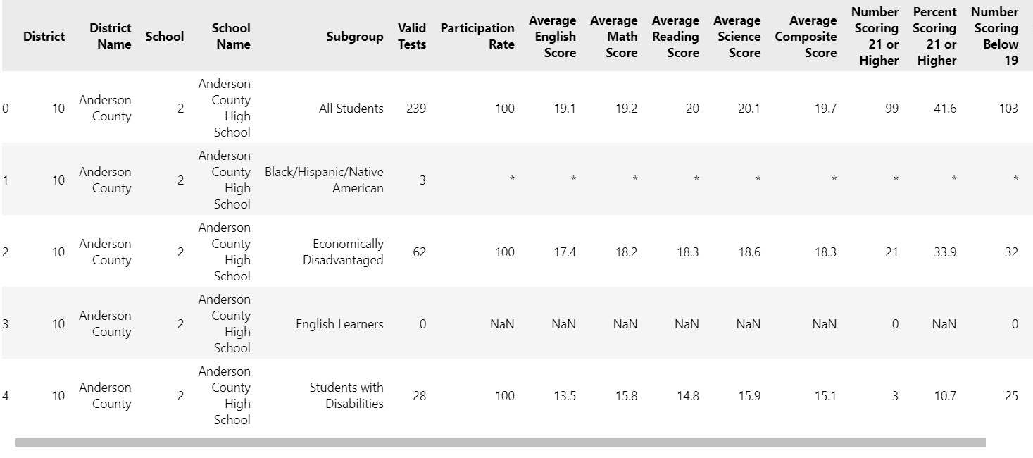
Data
Data is from public high schools only.
Focused on the ‘All Students’ subgroup for analysis.

Slide 4
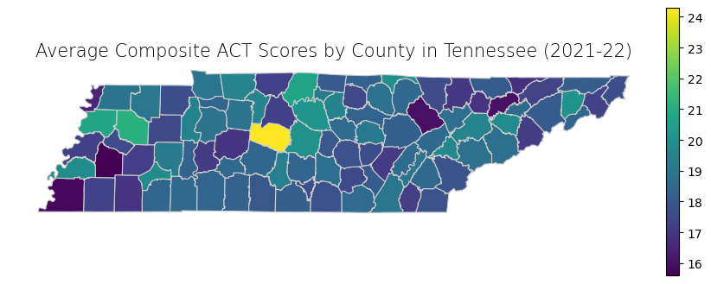
Composite ACT Scores by County (2022)
Williamson County had the highest average composite score of approximately 24.
Statewide average of 19.

Slide 5
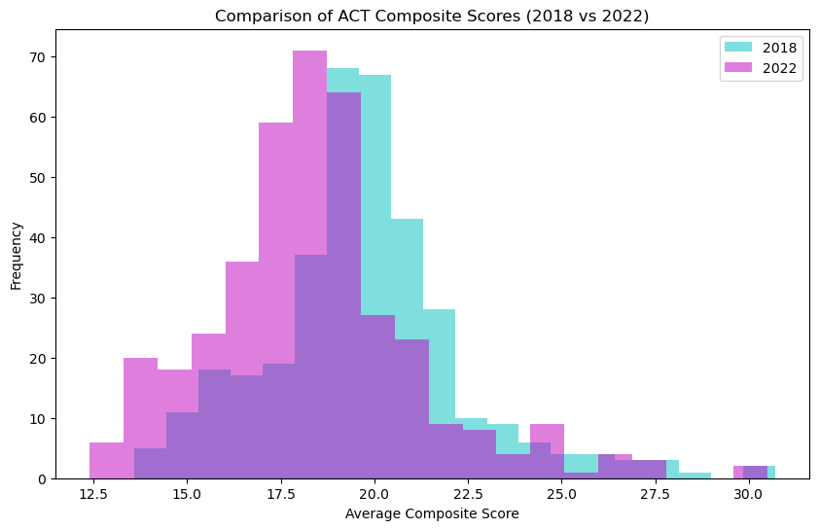
Comparing ACT Scores

Slide 6
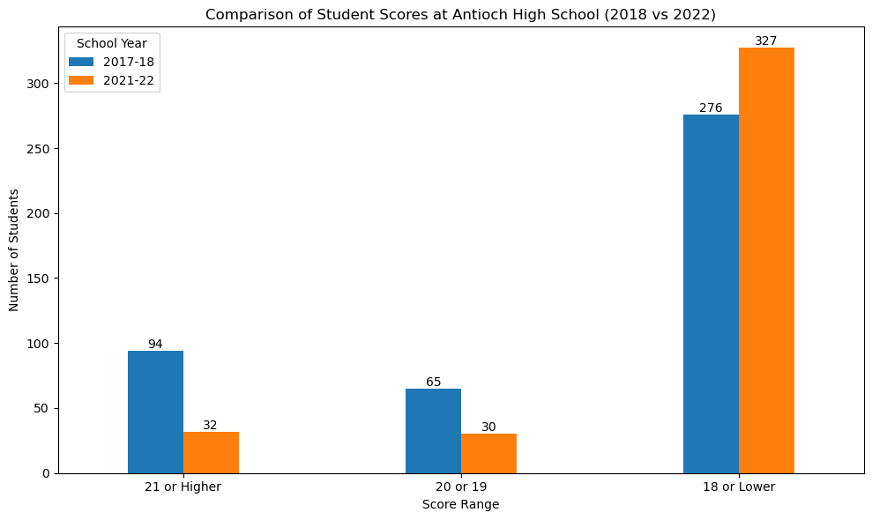
My High School: Then and Now

Slide 7
Takeaways
The statewide average of 19 means most students are not college ready.
The average ACT score decreased from 2018 to 2022.
The percent of students who made a 21 or higher in Antioch High School decreased from 21.61% to 8.22%

